Slide 1
NATURE OF COMPLAINTS
SWASTIKA INVESTMART LTD
Vishal Rathore

Slide 2
Introduction
Today, I'm excited to present our findings from a deep dive into customer complaints. Our primary goal? To better understand these complaints and, more importantly, to resolve them effectively.
Imagine each complaint as a unique story - one that highlights areas where we can improve. The focus of this analysis is to uncover the essence of these complaints, pinpointing their root causes, and finding solutions.
As you know, our commitment to customer satisfaction is unwavering. This presentation represents a pivotal step toward ensuring that commitment translates into action. We will explore the nature of these complaints, seeking patterns and insights that can guide our next steps.
In essence, we're embarking on a journey to listen, learn, and enhance the customer experience. Together, we'll unlock the potential for positive change, one complaint at a time.
Thank you for your time and attention. Let's begin our exploration.

Slide 3
AGENDA
Overview of Complaints Data
Nature of Complaints
Complaints Resolution Time
Amount Analysis
Feedback Analysis
Key Findings and Insights

Slide 4
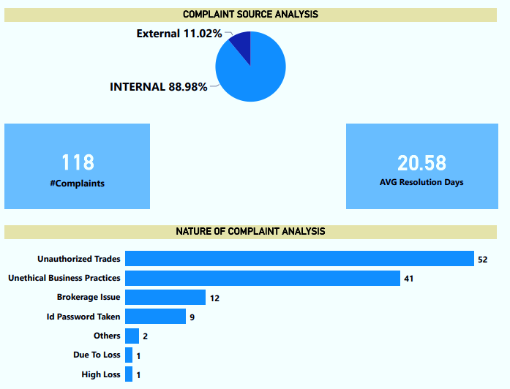
Overview of Complaints Data
Insights
Received 118 client complaints.
Average resolution time: 20.58 days.
Unauthorized Trades": 44.07% (52 complaints).
"Unethical Business Practices": 37.75%.
"Brokerage Issues": 10.17%.
3.39% related to 'due to loss,' 'High Loss,' and 'Others.‘
88.98% internal, 11.02% external.
Observation
The analysis reveals a high volume of customer complaints (118), emphasizing active engagement. However, the average resolution time of 20.58 days indicates a need for expedited response processes. Notably, the prevalence of unauthorized trades (44.07%) and unethical business practices (37.75%) demands urgent attention to enhance security measures and uphold ethical standards. Additionally, diverse complaint categories (3.39%) highlight nuanced concerns, requiring tailored solutions. Addressing internal challenges (88.98% of complaints) and refining external interactions (11.02%) are pivotal for a seamless customer experience. Streamlining processes, prioritizing security, and ensuring ethical practices are imperative for bolstering customer satisfaction and trust.

Slide 5
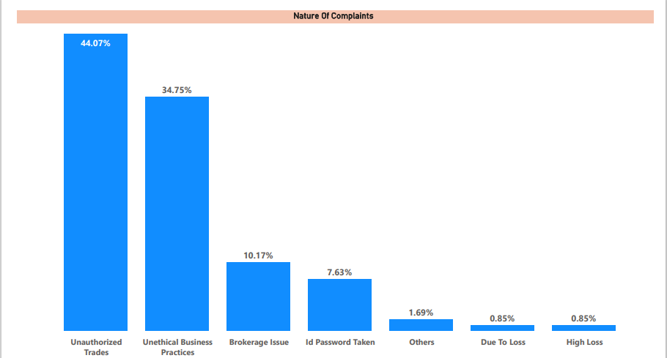
NATURE OF COMPLAINTS
Note-: Click on the hyper links to know about the details analysis of the above individual complaints.
Unauthorized Trades (44.07%) - Click Here
Unauthorized Business Practices (34.75%) – Click Here
Brokerage Issue (10.17%) – Click Here
ID Password Taken (7.63%) –
Others (1.69%)
Due to loss (1.70%)

Slide 6
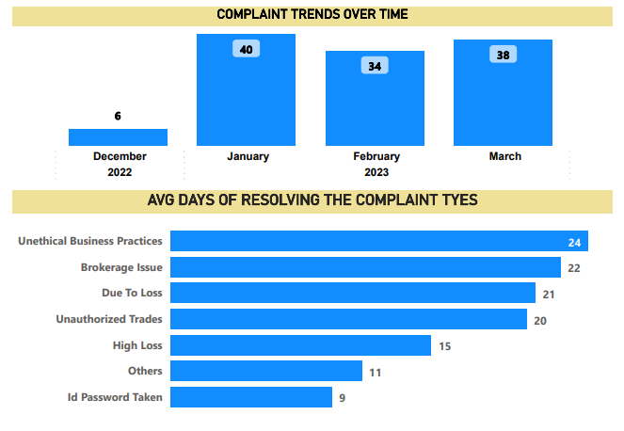
COMPLAINT RESOLUTION TIME
Data spans four consecutive months.
January 2023 had 40 major complaints, the highest count.
March 2023 also had a notable number of complaints.
December 2022 had only six complaints in comparison.
February 2023 saw 34 complaints recorded.
Currently, there is an upward trend in our complaints analysis efforts negatively.
Overall average complaint resolution time: 20.58 days.
Unethical business practices complaints resolved in 24 days on average.
Brokerage issues addressed within 22 days on average.
Resolution time for complaints related to loss: 21 days.
Unauthorized trades resolved within 20 days on average.
High loss complaints resolved within 15 days on average.
Complaints related to unauthorized ID/password usage resolved in 09 days on average.

Slide 7
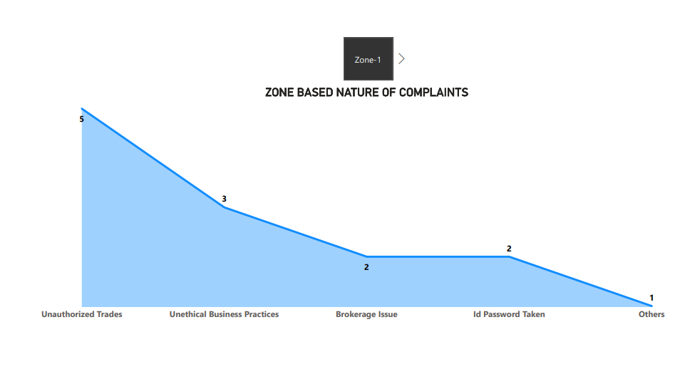
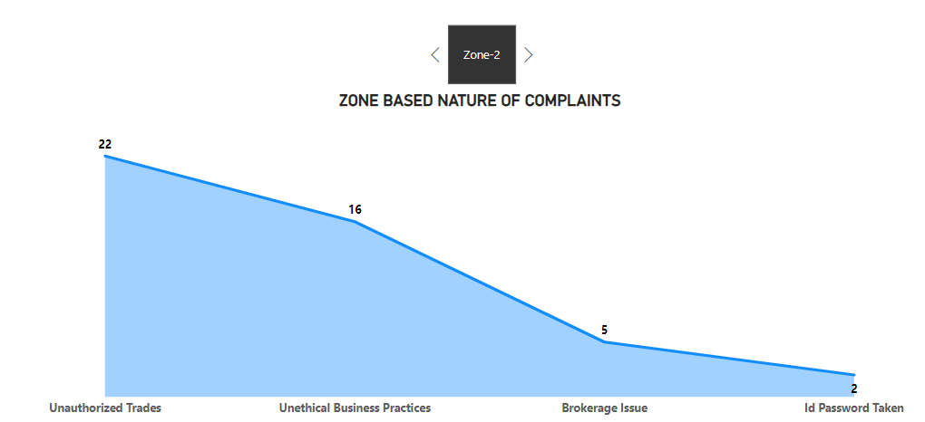
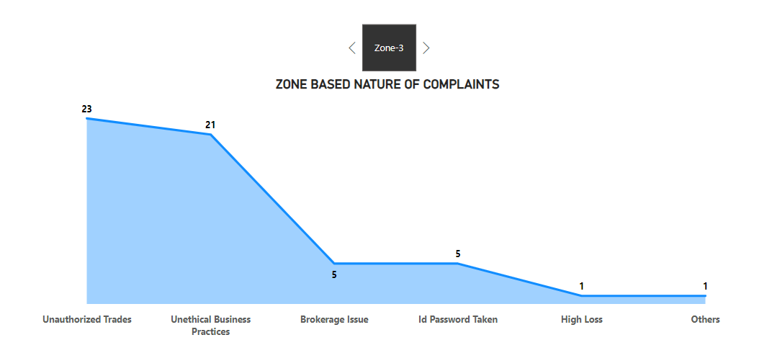
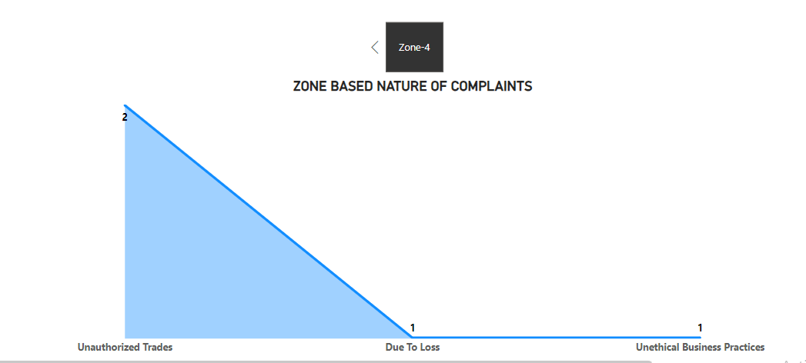
ZONE WISE COMPLAINT NATURE

Slide 8
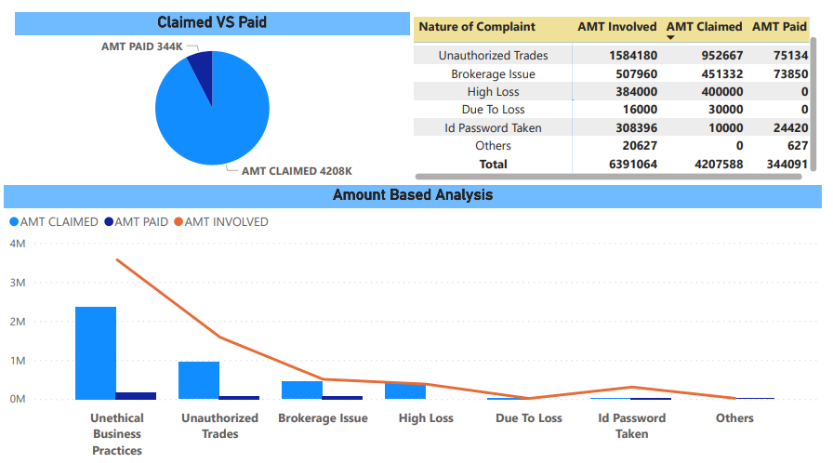
AMOUNT BASED DISTIBUTION ANALYSIS
"We manage three categories of amounts: 'Amount Involved' representing 100% of the total, 'Amount Claimed' covering 65.84%, and 'Amount Paid' comprising 5.38% of the total sum."

Slide 9
Unauthorized Trades
RCA
Action Taken by Branch
Action To Be Taken
Forced manual trades despite client's preference for algo trading.
Missing promised stop loss maintenance led to significant losses.
Unauthorized trades due to shared ID passwords and weak verification.
Absence of pre-trade confirmations contributed to unauthorized trades.
Poor communication channels resulted in misunderstandings and errors.
High brokerage charges impacted client investments negatively.
Errors by branch personnel led to unauthorized trades.
Incomplete trade recordings on the cloud hindered dispute resolution.
Instances of trades executed without client authorization.
Transparent fee structures and fair charges are vital for trust.
Implement strict pre-trade confirmation protocols to ensure client consent before executing any trades.
Strengthen cybersecurity measures to prevent unauthorized access and trading on client accounts.
Conduct regular training sessions for employees to emphasize the importance of client authorization and ethical trading practices.
Establish a robust complaint tracking system to monitor the status of each complaint and ensure timely resolution.
Enhance communication channels between clients and branch employees to address concerns promptly.
Develop a comprehensive client education program to educate clients about trading practices, risks, and safeguards.
Introduce a mandatory two-factor authentication process for all trades, adding an extra layer of security.
Implement a thorough review of all trades, ensuring adherence to regulations and client consent.
Periodically audit branch activities to identify and rectify potential issues related to client complaints.
Foster a culture of transparency and accountability within the organization, encouraging employees to report any unethical practices promptly.
Submitted reply to the exchange, resulting in closure of the complaint.
Resolved issue by refunding Rs. 14,000 out of Rs. 17,650 brokerage charged.
Reduced future brokerage charges to Rs. 10 per lot for fair trading practices.
Sent multiple emails to branches, ensuring consistent communication and issue resolution.
Continuous efforts made to engage with clients and resolve complaints via emails and calls.
Escalated complex cases to higher authorities, ensuring thorough investigation and resolution.

Slide 10
Unethical Business Practices
RCA
Action Taken by Branch
Action To Be Taken
Weak Access Controls: Unauthorized access led to illicit trades and losses.
Lack of Verification Protocols: Trades executed without explicit client authorization.
Employee Misconduct: Coercion and unethical practices caused financial losses.
Insufficient Training: Staff lacked training in ethical trading practices.
Social Media Neglect: Public airing of grievances damaged the company's reputation.
Inadequate Monitoring: Unauthorized activities went unnoticed due to lax monitoring.
Misuse of Client Funds: Improper handling of funds, including personal transfers, occurred.
Poor Communication: Clients relied on unverified tips due to inadequate communication.
Lack of Internal Oversight: Absence of rigorous audits allowed fraudulent activities.
Client Trust Erosion: Continuous breaches eroded client trust, necessitating urgent corrective actions.
Guided the client not to share ID and password; issued warnings to the AP.
Investigated leads from advisory firms, seeking proof from unresponsive clients.
Released AP's brokerage upon Deepak Sir's request.
Educated clients lacking F&O knowledge; offered mutual settlement and brokerage reversals.
Handling an ongoing arbitration case; only Rs. 2000 held currently.
Settled various cases; issued warnings to AP.
Faced unresponsiveness from the branch in some cases; clients stopped escalating issues.
Dealt with incomplete recordings; awaiting approval to release AP's funds.
Resolved cases through teleconferencing; received closure mails from clients.
Educate clients about secure trading practices and the importance of safeguarding personal information.
Implement strict adherence to ethical trading practices for Authorized Persons (APs) and enforce penalties for violations.
Strengthen monitoring of AP activities through regular audits and surprise checks to deter fraudulent practices.
Establish stringent client verification protocols, including multi-factor authentication, to ensure client consent before initiating any transaction.
Improve communication channels between clients, APs, and the branch to maintain transparency and trust.
Develop a rapid response mechanism to address client complaints promptly and maintain constant communication during the resolution process.
Conduct regular training sessions for clients and APs, focusing on secure trading practices and recognizing potential fraud indicators.
Strengthen compliance mechanisms, conducting regular audits and checks on AP activities to ensure all trades are validated against client authorization.

Slide 11
BROKERAGE ISSUE
RCA
Action Taken by Branch
Action To Be Taken
Clients frustrated by unclear explanations for high brokerage charges.
Lack of transparency led to client distrust and dissatisfaction.
Unauthorized heavy trades resulted in unexpectedly high charges.
Commitment disparities with relationship managers caused confusion.
Brokerage charges surpassed SEBI limits, indicating potential violations.
Improper guidance led to incorrect trades and excessive charges.
New clients faced unexpected high charges due to unclear policies.
Clients complained about insufficient resolution of previous issues.
Clients faced unexpected high charges due to unclear guidance.
Discrepancies between promised service and actual delivery led to complaints.
Resolve teleconferencing issues promptly.
Ensure clear communication with branches.
Investigate discrepancies, seek AP explanation.
Refund client promptly (e.g., Rs. 7200).
Revert excess brokerage (e.g., 88972 Rs) to client.
Review client recordings for accurate assessment.
Pursue mutual settlement, await exchange confirmation.
Settle with AP (e.g., Rs. 7790) for resolution.
Provide detailed response to exchange queries.
Resolve matters, compensate (e.g., 5000 Rs) for closure.
Teleconferencing with exchange resolved.
Sent communication to branch.
Investigation pending, awaiting AP response.
Credited Rs. 7200 to client.
Reversed 88972 Rs brokerage to client.
Client recordings under review.
Mutual settlement pending exchange confirmation.
AP settled with Rs. 7790.
Exchange response sent.
Settled with 5000 payout.

Slide 12
KEY FINDINGS AND INSIGHTS
This analysis reveals crucial patterns in customer complaints. January 2023 saw a peak with 40 cases, suggesting heightened customer dissatisfaction. Notably, complaints dwindled from December 2022 to February 2023, a positive trend. The average resolution time is 20.58 days, indicating our commitment to swift solutions. Unethical business practices complaints took 24 days to resolve, the longest, indicating complexities. Brokerage-related issues averaged 22 days, highlighting the need for streamlined processes. Unauthorized trades and loss-related complaints both took 20 days, emphasizing the necessity for improved risk management. We handle three main amount categories: 'Amount Involved' (100%), 'Amount Claimed' (65.84%), and 'Amount Paid' (5.38%), outlining the financial scope of our cases. To enhance service, proactive client engagement, stringent security measures, and regular feedback loops are imperative. Continuous improvement strategies, including staff training and adherence to regulatory guidelines, are pivotal for sustained customer satisfaction and loyalty.
Poor Communication: Lack of clear communication between clients and brokers, leading to misunderstandings and dissatisfaction.
Inadequate Risk Management: Insufficient risk assessment and management strategies, resulting in unauthorized trades and financial losses.
Faulty Brokerage Practices: Flawed brokerage calculations and improper disclosure of charges, causing client grievances over high brokerage fees.
Ineffective Security Measures: Weaknesses in client data protection and authorization processes, allowing unauthorized access and misuse of accounts.
Training Gaps: Insufficient training of staff and brokers, leading to errors in trade execution, client handling, and compliance, contributing to complaints.

Slide 13
SUGGETIONS
Enhanced Client Education: Implement comprehensive client education programs to ensure understanding of trading processes, charges, and risks.
Improved Communication Channels: Establish clear and accessible communication channels for clients to address concerns promptly and effectively.
Stricter Security Protocols: Strengthen account security measures, including multi-factor authentication, to prevent unauthorized access.
Robust Training for Staff: Provide rigorous training to staff and brokers, focusing on accurate trade execution, client engagement, and regulatory compliance.
Transparent Fee Structures: Clearly outline brokerage fees and trading charges, ensuring clients are informed and aware of the costs involved.
Regular Compliance Audits: Conduct regular internal audits to ensure compliance with regulations and ethical trading practices.
Proactive Issue Resolution: Set up a dedicated team to proactively identify and resolve client issues before they escalate into formal complaints.
Data Analytics for Patterns: Utilize data analytics to identify recurring issues and patterns, enabling proactive measures to prevent similar complaints.
Client Feedback Loop: Establish a feedback loop where client complaints are analyzed, leading to process improvements and better client satisfaction.
Continuous Regulatory Updates: Stay abreast of regulatory changes and ensure full compliance to maintain client trust and confidence.

Slide 14
Conclusions
In conclusion, our thorough analysis of client complaints has provided invaluable insights. By addressing root causes, enhancing communication, and fortifying security measures, we can significantly improve client satisfaction. Transparency, education, and proactive issue resolution are key. Embracing these strategies not only resolves existing concerns but also fosters a client-centric culture, ensuring Swastika remains a trusted partner in the financial journey of our clients.

Slide 15
Thank you

